Slide 1

Hi-Landers Ham Class
Instructed by Rich Bugarin W6EC

Slide 2
Sub-element 10 of 10

Slide 3
Ham Radio Technician Class Exam preparation Power Point created by Rich Bugarin W6EC.
Effective July 1, 2022 and is valid until June 30, 2026.
Please send suggested changes to this presentation to:
w6ec@thebugarins.com

Slide 4
Study Hints
I suggest you read each question and only the correct answer. Read through the complete question pool at least three times before you attempt taking a practice exams. For higher impact and better results read the correct answer first then the question and again the correct answer.
The key to passing the exam is to get the most questions correct using the above method the correct response will often jump out at you on test day even if you don’t remember the question.

Slide 5
Text Color
Black: Original/Official questions and information in original format (unaltered).
Red: Original information text color simply changed to highlight subject.
Blue: Notes and information added by Rich (W6EC).

Slide 6
SUBELEMENT T0 – SAFETY
[3 Exam Questions - 3 Groups]

Slide 7
T0A – Power circuits and hazards: hazardous voltages, fuses and circuit breakers, grounding, electrical code compliance; Lightning protection; Battery safety
#33 of 35

Slide 8
T0A01
Which of the following is a safety hazard of a 12-volt storage battery?
A. Touching both terminals with the hands can cause electrical shock
B. Shorting the terminals can cause burns, fire, or an explosion
C. RF emissions from a nearby transmitter can cause the electrolyte to emit poison gas
D. All these choices are correct

Slide 9
T0A01
Which of the following is a safety hazard of a 12-volt storage battery?
A. Touching both terminals with the hands can cause electrical shock
B. Shorting the terminals can cause burns, fire, or an explosion
C. RF emissions from a nearby transmitter can cause the electrolyte to emit poison gas
D. All these choices are correct

Slide 10
T0A02
What health hazard is presented by electrical current flowing through the body?
A. It may cause injury by heating tissue
B. It may disrupt the electrical functions of cells
C. It may cause involuntary muscle contractions
D. All these choices are correct

Slide 11
T0A02
What health hazard is presented by electrical current flowing through the body?
A. It may cause injury by heating tissue
B. It may disrupt the electrical functions of cells
C. It may cause involuntary muscle contractions
D. All these choices are correct

Slide 12
T0A03
In the United States, what circuit does black wire insulation indicate in a three-wire 120 V cable?
A. Neutral
B. Hot
C. Equipment ground
D. Black insulation is never used

Slide 13
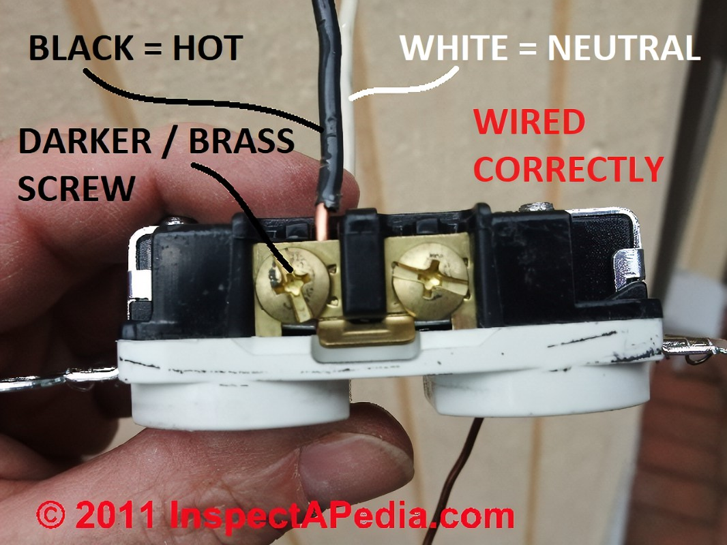
T0A03
In the United States, what circuit does black wire insulation indicate in a three-wire 120 V cable?
A. Neutral
B. Hot
C. Equipment ground
D. Black insulation is never used

Slide 14
T0A04
What is the purpose of a fuse in an electrical circuit?
A. To prevent power supply ripple from damaging a component
B. To remove power in case of overload
C. To limit current to prevent shocks
D. All these choices are correct

Slide 15
T0A04
What is the purpose of a fuse in an electrical circuit?
A. To prevent power supply ripple from damaging a component
B. To remove power in case of overload
C. To limit current to prevent shocks
D. All these choices are correct

Slide 16
T0A05
Why should a 5-ampere fuse never be replaced with a 20-ampere fuse?
A. The larger fuse would be likely to blow because it is rated for higher current
B. The power supply ripple would greatly increase
C. Excessive current could cause a fire
D. All these choices are correct

Slide 17
T0A05
Why should a 5-ampere fuse never be replaced with a 20-ampere fuse?
A. The larger fuse would be likely to blow because it is rated for higher current
B. The power supply ripple would greatly increase
C. Excessive current could cause a fire
D. All these choices are correct

Slide 18
T0A06
What is a good way to guard against electrical shock at your station?
A. Use three-wire cords and plugs for all AC powered equipment
B. Connect all AC powered station equipment to a common safety ground
C. Install mechanical interlocks in high-voltage circuits
D. All these choices are correct

Slide 19
T0A06
What is a good way to guard against electrical shock at your station?
A. Use three-wire cords and plugs for all AC powered equipment
B. Connect all AC powered station equipment to a common safety ground
C. Install mechanical interlocks in high-voltage circuits
D. All these choices are correct

Slide 20
T0A07
Where should a lightning arrester be installed in a coaxial feed line?
A. At the output connector of a transceiver
B. At the antenna feed point
C. At the ac power service panel
D. On a grounded panel near where feed lines enter the building

Slide 21
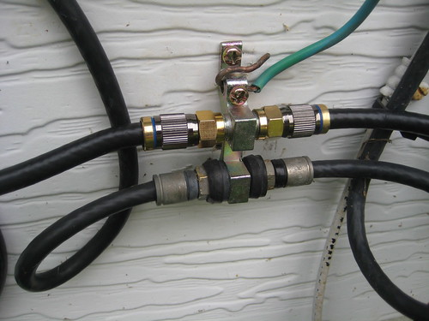
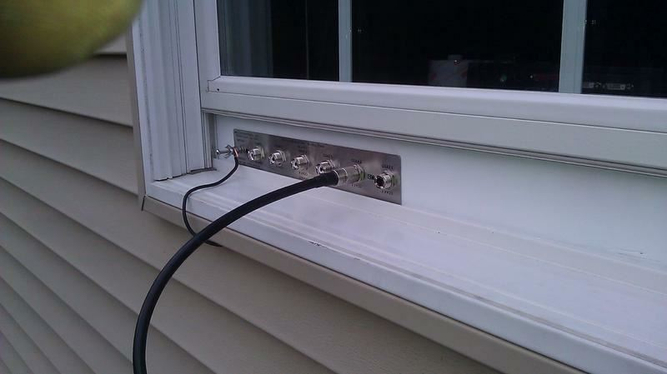
T0A07
Where should a lightning arrester be installed in a coaxial feed line?
A. At the output connector of a transceiver
B. At the antenna feed point
C. At the ac power service panel
D. On a grounded panel near where feed lines enter the building

Slide 22
T0A08
Where should a fuse or circuit breaker be installed in a 120V AC power circuit?
A. In series with the hot conductor only
B. In series with the hot and neutral conductors
C. In parallel with the hot conductor only
D. In parallel with the hot and neutral conductors

Slide 23
T0A08
Where should a fuse or circuit breaker be installed in a 120V AC power circuit?
A. In series with the hot conductor only
B. In series with the hot and neutral conductors
C. In parallel with the hot conductor only
D. In parallel with the hot and neutral conductors

Slide 24
T0A09
What should be done to all external ground rods or earth connections?
A. Waterproof them with silicone caulk or electrical tape
B. Keep them as far apart as possible
C. Bond them together with heavy wire or conductive strap
D. Tune them for resonance on the lowest frequency of operation

Slide 25
T0A09
What should be done to all external ground rods or earth connections?
A. Waterproof them with silicone caulk or electrical tape
B. Keep them as far apart as possible
C. Bond them together with heavy wire or conductive strap
D. Tune them for resonance on the lowest frequency of operation

Slide 26
T0A10
What hazard is caused by charging or discharging a battery too quickly?
A. Overheating or out-gassing
B. Excess output ripple
C. Half-wave rectification
D. Inverse memory effect

Slide 27
T0A10
What hazard is caused by charging or discharging a battery too quickly?
A. Overheating or out-gassing
B. Excess output ripple
C. Half-wave rectification
D. Inverse memory effect

Slide 28
T0A11
What hazard exists in a power supply immediately after turning it off?
A. Circulating currents in the dc filter
B. Leakage flux in the power transformer
C. Voltage transients from kickback diodes
D. Charge stored in filter capacitors
Notes:
Not all

Slide 29
T0A11
What hazard exists in a power supply immediately after turning it off?
A. Circulating currents in the dc filter
B. Leakage flux in the power transformer
C. Voltage transients from kickback diodes
D. Charge stored in filter capacitors
Notes:
Not all

Slide 30
T0A12
Which of the following precautions should be taken when measuring high voltages with a voltmeter?
A. Ensure that the voltmeter has very low impedance
B. Ensure that the voltmeter and leads are rated for use at the voltages to be measured
C. Ensure that the circuit is grounded through the voltmeter
D. Ensure that the voltmeter is set to the correct frequency

Slide 31
T0A12
Which of the following precautions should be taken when measuring high voltages with a voltmeter?
A. Ensure that the voltmeter has very low impedance
B. Ensure that the voltmeter and leads are rated for use at the voltages to be measured
C. Ensure that the circuit is grounded through the voltmeter
D. Ensure that the voltmeter is set to the correct frequency

Slide 32
T0B – Antenna safety: tower safety and grounding, installing antennas, antenna supports
#34 of 35

Slide 33
T0B01
Which of the following is good practice when installing ground wires on a tower for lightning protection?
A. Put a drip loop in the ground connection to prevent water damage to the ground system
B. Make sure all ground wire bends are right angles
C. Ensure that connections are short and direct
D. All these choices are correct

Slide 34
T0B01
Which of the following is good practice when installing ground wires on a tower for lightning protection?
A. Put a drip loop in the ground connection to prevent water damage to the ground system
B. Make sure all ground wire bends are right angles
C. Ensure that connections are short and direct
D. All these choices are correct

Slide 35
T0B02
What is required when climbing an antenna tower?
A. Have sufficient training on safe tower climbing techniques
B. Use appropriate tie-off to the tower at all times
C. Always wear an approved climbing harness
D. All these choices are correct

Slide 36
T0B02
What is required when climbing an antenna tower?
A. Have sufficient training on safe tower climbing techniques
B. Use appropriate tie-off to the tower at all times
C. Always wear an approved climbing harness
D. All these choices are correct

Slide 37
T0B03
Under what circumstances is it safe to climb a tower without a helper or observer?
A. When no electrical work is being performed
B. When no mechanical work is being performed
C. When the work being done is not more than 20 feet above the ground
D. Never

Slide 38
T0B03
Under what circumstances is it safe to climb a tower without a helper or observer?
A. When no electrical work is being performed
B. When no mechanical work is being performed
C. When the work being done is not more than 20 feet above the ground
D. Never

Slide 39
T0B04
Which of the following is an important safety precaution to observe when putting up an antenna tower?
A. Wear a ground strap connected to your wrist at all times
B. Insulate the base of the tower to avoid lightning strikes
C. Look for and stay clear of any overhead electrical wires
D. All these choices are correct

Slide 40
T0B04
Which of the following is an important safety precaution to observe when putting up an antenna tower?
A. Wear a ground strap connected to your wrist at all times
B. Insulate the base of the tower to avoid lightning strikes
C. Look for and stay clear of any overhead electrical wires
D. All these choices are correct

Slide 41
T0B05
What is the purpose of a safety wire through a turnbuckle used to tension guy lines?
A. Secure the guy line if the turnbuckle breaks
B. Prevent loosening of the turnbuckle from vibration
C. Provide a ground path for lightning strikes
D. Provide an ability to measure for proper tensioning

Slide 42
T0B05
What is the purpose of a safety wire through a turnbuckle used to tension guy lines?
A. Secure the guy line if the turnbuckle breaks
B. Prevent loosening of the turnbuckle from vibration
C. Provide a ground path for lightning strikes
D. Provide an ability to measure for proper tensioning

Slide 43
T0B06
What is the minimum safe distance from a power line to allow when installing an antenna?
A. Add the height of the antenna to the height of the power line and multiply by a factor of 1.5
B. The height of the power line above ground
C. 1/2 wavelength at the operating frequency
D. Enough so that if the antenna falls, no part of it can come closer than 10 feet to the power wires

Slide 44
T0B06
What is the minimum safe distance from a power line to allow when installing an antenna?
A. Add the height of the antenna to the height of the power line and multiply by a factor of 1.5
B. The height of the power line above ground
C. 1/2 wavelength at the operating frequency
D. Enough so that if the antenna falls, no part of it can come closer than 10 feet to the power wires

Slide 45
T0B07
Which of the following is an important safety rule to remember when using a crank-up tower?
A. This type of tower must never be painted
B. This type of tower must never be grounded
C. This type of tower must not be climbed unless it is retracted, or mechanical safety locking devices have been installed
D. All these choices are correct
Notes:
Not all

Slide 46
T0B07
Which of the following is an important safety rule to remember when using a crank-up tower?
A. This type of tower must never be painted
B. This type of tower must never be grounded
C. This type of tower must not be climbed unless it is retracted, or mechanical safety locking devices have been installed
D. All these choices are correct
Notes:
Not all

Slide 47
T0B08
Which is a proper grounding method for a tower?
A. A single four-foot ground rod, driven into the ground no more than 12 inches from the base
B. A ferrite-core RF choke connected between the tower and ground
C. A connection between the tower base and a cold water pipe
D. Separate eight-foot ground rods for each tower leg, bonded to the tower and each other

Slide 48
T0B08
Which is a proper grounding method for a tower?
A. A single four-foot ground rod, driven into the ground no more than 12 inches from the base
B. A ferrite-core RF choke connected between the tower and ground
C. A connection between the tower base and a cold water pipe
D. Separate eight-foot ground rods for each tower leg, bonded to the tower and each other

Slide 49
T0B09
Why should you avoid attaching an antenna to a utility pole?
A. The antenna will not work properly because of induced voltages
B. The 60 Hz radiations from the feed line may increase the SWR
C. The antenna could contact high-voltage power lines
D. All these choices are correct

Slide 50
T0B09
Why should you avoid attaching an antenna to a utility pole?
A. The antenna will not work properly because of induced voltages
B. The 60 Hz radiations from the feed line may increase the SWR
C. The antenna could contact high-voltage power lines
D. All these choices are correct

Slide 51
T0B10
Which of the following is true when installing grounding conductors used for lightning protection?
A. Use only non-insulated wire
B. Wires must be carefully routed with precise right-angle bends
C. Sharp bends must be avoided
D. Common grounds must be avoided

Slide 52
T0B10
Which of the following is true when installing grounding conductors used for lightning protection?
A. Use only non-insulated wire
B. Wires must be carefully routed with precise right-angle bends
C. Sharp bends must be avoided
D. Common grounds must be avoided

Slide 53
T0B11
Which of the following establishes grounding requirements for an amateur radio tower or antenna?
A. FCC Part 97 rules
B. Local electrical codes
C. FAA tower lighting regulations
D. UL recommended practices

Slide 54
T0B11
Which of the following establishes grounding requirements for an amateur radio tower or antenna?
A. FCC Part 97 rules
B. Local electrical codes
C. FAA tower lighting regulations
D. UL recommended practices

Slide 55
T0C - RF hazards: radiation exposure, proximity to antennas, recognized safe power levels, radiation types, duty cycle
#35 of 35

Slide 56
T0C01
What type of radiation are radio signals?
A. Gamma radiation
B. Ionizing radiation
C. Alpha radiation
D. Non-ionizing radiation

Slide 57
T0C01
What type of radiation are radio signals?
A. Gamma radiation
B. Ionizing radiation
C. Alpha radiation
D. Non-ionizing radiation

Slide 58
T0C02
At which of the following frequencies does maximum permissible exposure have the lowest value?
A. 3.5 MHz
B. 50 MHz
C. 440 MHz
D. 1296 MHz

Slide 59
T0C02
At which of the following frequencies does maximum permissible exposure have the lowest value?
A. 3.5 MHz
B. 50 MHz
C. 440 MHz
D. 1296 MHz

Slide 60
T0C03
How does the allowable power density for RF safety change if duty cycle changes from 100 percent to 50 percent?
A. It increases by a factor of 3
B. It decreases by 50 percent
C. It increases by a factor of 2
D. There is no adjustment allowed for lower duty cycle

Slide 61
T0C03
How does the allowable power density for RF safety change if duty cycle changes from 100 percent to 50 percent?
A. It increases by a factor of 3
B. It decreases by 50 percent
C. It increases by a factor of 2
D. There is no adjustment allowed for lower duty cycle

Slide 62
T0C04
What factors affect the RF exposure of people near an amateur station antenna?
A. Frequency and power level of the RF field
B. Distance from the antenna to a person
C. Radiation pattern of the antenna
D. All these choices are correct

Slide 63
T0C04
What factors affect the RF exposure of people near an amateur station antenna?
A. Frequency and power level of the RF field
B. Distance from the antenna to a person
C. Radiation pattern of the antenna
D. All these choices are correct

Slide 64
T0C05
Why do exposure limits vary with frequency?
A. Lower frequency RF fields have more energy than higher frequency fields
B. Lower frequency RF fields do not penetrate the human body
C. Higher frequency RF fields are transient in nature
D. The human body absorbs more RF energy at some frequencies than at others

Slide 65
T0C05
Why do exposure limits vary with frequency?
A. Lower frequency RF fields have more energy than higher frequency fields
B. Lower frequency RF fields do not penetrate the human body
C. Higher frequency RF fields are transient in nature
D. The human body absorbs more RF energy at some frequencies than at others

Slide 66
T0C06
Which of the following is an acceptable method to determine whether your station complies with FCC RF exposure regulations?
A. By calculation based on FCC OET Bulletin 65
B. By calculation based on computer modeling
C. By measurement of field strength using calibrated equipment
D. All these choices are correct
Notes:
all

Slide 67
T0C06
Which of the following is an acceptable method to determine whether your station complies with FCC RF exposure regulations?
A. By calculation based on FCC OET Bulletin 65
B. By calculation based on computer modeling
C. By measurement of field strength using calibrated equipment
D. All these choices are correct
Notes:
all

Slide 68
T0C07
What hazard is created by touching an antenna during a transmission?
A. Electrocution
B. RF burn to skin
C. Radiation poisoning
D. All these choices are correct

Slide 69
T0C07
What hazard is created by touching an antenna during a transmission?
A. Electrocution
B. RF burn to skin
C. Radiation poisoning
D. All these choices are correct

Slide 70
T0C08
Which of the following actions can reduce exposure to RF radiation?
A. Relocate antennas
B. Relocate the transmitter
C. Increase the duty cycle
D. All these choices are correct

Slide 71
T0C08
Which of the following actions can reduce exposure to RF radiation?
A. Relocate antennas
B. Relocate the transmitter
C. Increase the duty cycle
D. All these choices are correct

Slide 72
T0C09
How can you make sure your station stays in compliance with RF safety regulations?
A. By informing the FCC of any changes made in your station
B. By re-evaluating the station whenever an item in the transmitter or antenna system is changed
C. By making sure your antennas have low SWR
D. All these choices are correct
Notes:
Not all

Slide 73
T0C09
How can you make sure your station stays in compliance with RF safety regulations?
A. By informing the FCC of any changes made in your station
B. By re-evaluating the station whenever an item in the transmitter or antenna system is changed
C. By making sure your antennas have low SWR
D. All these choices are correct
Notes:
Not all

Slide 74
T0C10
Why is duty cycle one of the factors used to determine safe RF radiation exposure levels?
A. It affects the average exposure to radiation
B. It affects the peak exposure to radiation
C. It takes into account the antenna feed line loss
D. It takes into account the thermal effects of the final amplifier

Slide 75
T0C10
Why is duty cycle one of the factors used to determine safe RF radiation exposure levels?
A. It affects the average exposure to radiation
B. It affects the peak exposure to radiation
C. It takes into account the antenna feed line loss
D. It takes into account the thermal effects of the final amplifier

Slide 76
T0C11
What is the definition of duty cycle during the averaging time for RF exposure?
A. The difference between the lowest power output and the highest power output of a transmitter
B. The difference between the PEP and average power output of a transmitter
C. The percentage of time that a transmitter is transmitting
D. The percentage of time that a transmitter is not transmitting

Slide 77
T0C11
What is the definition of duty cycle during the averaging time for RF exposure?
A. The difference between the lowest power output and the highest power output of a transmitter
B. The difference between the PEP and average power output of a transmitter
C. The percentage of time that a transmitter is transmitting
D. The percentage of time that a transmitter is not transmitting

Slide 78
T0C12
How does RF radiation differ from ionizing radiation (radioactivity)?
A. RF radiation does not have sufficient energy to cause chemical changes in cells and damage DNA
B. RF radiation can only be detected with an RF dosimeter
C. RF radiation is limited in range to a few feet
D. RF radiation is perfectly safe

Slide 79
T0C12
How does RF radiation differ from ionizing radiation (radioactivity)?
A. RF radiation does not have sufficient energy to cause chemical changes in cells and damage DNA
B. RF radiation can only be detected with an RF dosimeter
C. RF radiation is limited in range to a few feet
D. RF radiation is perfectly safe

Slide 80
T0C13
Who is responsible for ensuring that no person is exposed to RF energy above the FCC exposure limits?
A. The FCC
B. The station licensee
C. Anyone who is near an antenna
D. The local zoning board

Slide 81
T0C13
Who is responsible for ensuring that no person is exposed to RF energy above the FCC exposure limits?
A. The FCC
B. The station licensee
C. Anyone who is near an antenna
D. The local zoning board

Slide 82
End of Sub-element 10
---- End of Test Pool----

Slide 83
Now it is time to study, study, study.
You need to read each test question and its correct answer a minimum of 3 times each.
(I suggest more)

Slide 84
Study Hints
I suggest you read each question and only the correct answer. Read through the complete question pool at least three times before you attempt taking a practice exams. For higher impact and better results read the correct answer first then the question and again the correct answer.
The key to passing the exam is to get the most questions correct using the above method the correct response will often jump out at you on test day even if you don’t remember the question.

Slide 85
More Study Hints
If you don’t answer a question on the Exam it will be graded as a wrong response, so it is better to guess at a answer than leaving it blank. You have a 25% chance at guessing a correct answer. Eliminate one wrong response and now your guess has a 33% chance. Eliminate two wrong response and your guess is a 50% chance at being correct.

Slide 86
More Guessing Hints
The author of a question pays more attention on writing the correct response then they do to the wrong ones therefore the correct response is often a longer answer.
So when guessing consider the longest answer for it is “to long to be wrong”.

Slide 87
Things I have noticed
The response/answer
“All of these Answer (choices) are correct”
shows up 68 times in the element Two question pool and is a correct response 23 times.
So when guessing don’t choose “all of these” for it will be correct response only 33% of the time.

Slide 88
2022 Technician Class (Element 2)
There are 412 questions in this pool out of which you will have 35 on your Exam. The question pool is broken into sub-elements. Sub-elements are also subdivided into 35 topic sections. You will have one question from each section on your official Exam.
Good news this exam pool has 30 less questions to study compared to the 2018 pool.

Slide 89
When you think you are ready you can use this PowerPoint presentation as a self test.
Choose your answer then click next to reveal the answer.

Slide 90

End of Presentation
Thank you now pass that exam and make Rich W6EC proud.

